Slide 1
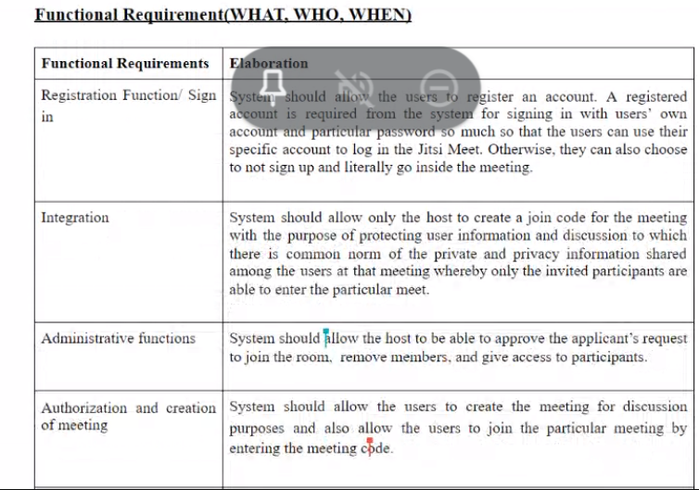

Slide 2
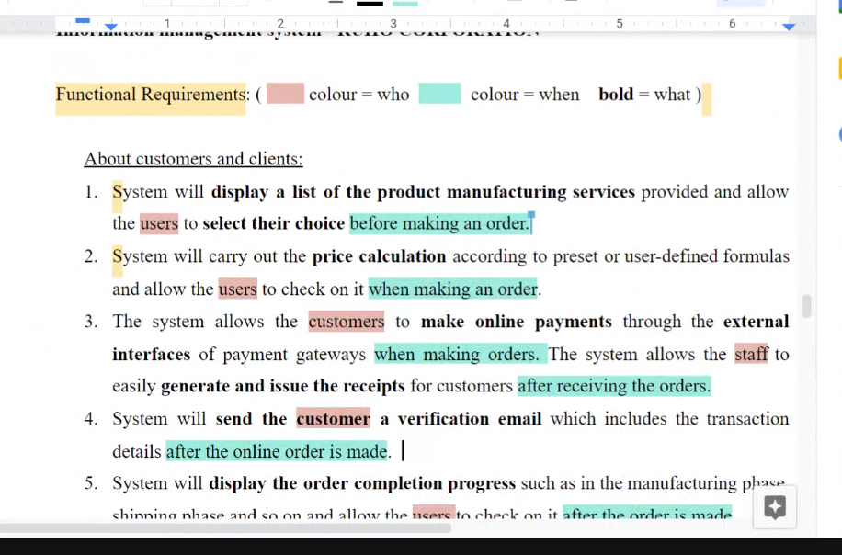

Slide 3
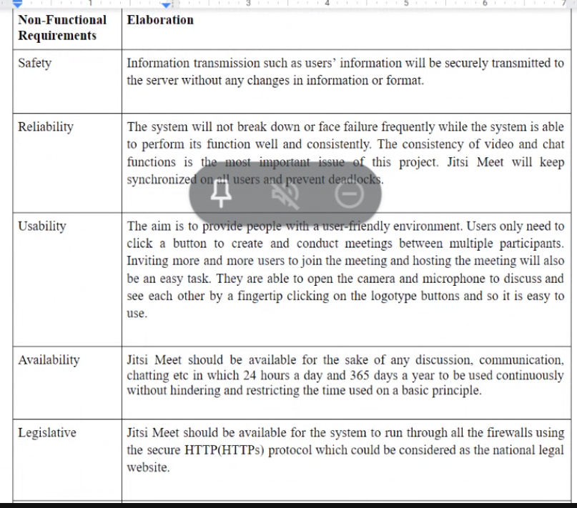

Slide 4
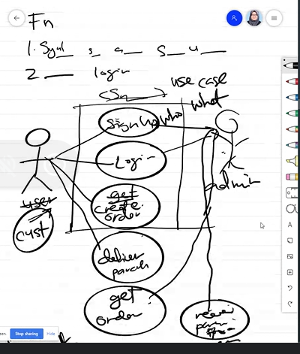

Slide 5
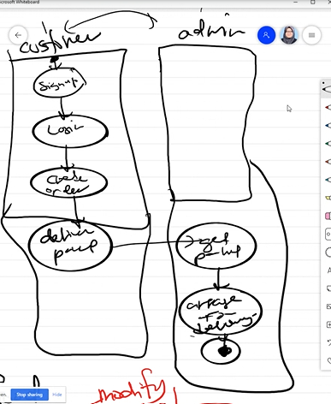

Slide 6
Reliability
Users can use "Update Client" during 98% of normal working hours.
Maintainability
Defines the time required for a solution or its component to be fixed, changed to increase performance or other qualities, or adapted to a changing environment.
Scalability
Scalability assesses the highest workloads under which the system will still meet the performance requirements.
Usability
Classical nonfunctional requirement that addresses a simple question and define the requirements isn’t as easy to seems.
Security
Process: Only users with the role of "Customer Advisor" or "Supervisor" can access "Update Customer". Data: Only users in the role of "Supervisor" can update the customer's date of birth.
Performance
During the "update customer" process, the system response should not exceed 1 second.
Portability
Portability defines how to start a system or its elements in one environment or another. It usually includes hardware, software or other usage platform specifications. In short, it determines the execution of actions performed by one platform on another platform. Moreover, it specifies the degree to which system elements can be well accessed and can interact in two different environments.
Accuracy requirements
The data change time must be recorded to the nearest second.
Concurrency Requirements
Up to 300 users may be using "Update Customer" at any one time.
Data integrity
Data integrity refers to maintaining and assuring data accuracy and consistency over its entire lifecycle.
Interoperability
All system components must follow a common and standard set of exchange formats to exchange data; the lack of interoperability happens when people do not follow standards.
Recoverability
Recoverability is the ability to recover from a system crash or failure and return to full operation.
Capacity
Process: A total of up to 500 users can use "Update Customer". Data: Up to 1,000,000 customers can be stored.
Accessibility Requirements
The help page should be provided in multiple languages, for example English, Malay and Chinese.
Error-Handling
If the user exits the "order" process, everything the user does will be saved.

